Slide 1

LOAN PREDICTION
GROUP-1
Mentor Name: Mr. Parth
Date: 21-05-2021
Prepared by: Amit Kulkarni

Slide 2
Business Problem:
To predict the impact of the incident raised by the customer.
Objective:
To automate the loan eligibility process (real time) based on customer detail provided while filling online application form.

Slide 3
PROJECT FLOW
Understanding Dataset
Data Visualization
Modelling
Feature Engineering
Re-Build Model
Predictions
Data Processing

Slide 4

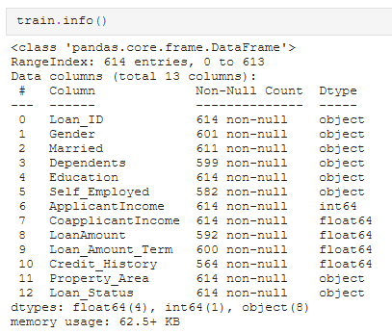
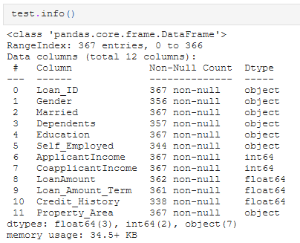
Understanding Data-Set

Slide 5
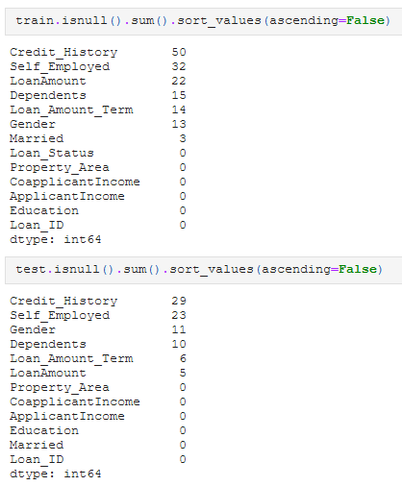
Understanding Data-Set

Slide 6
Inferences from given Data-Set
There are 614 records in the Train Dataset & 367 records in the Test Dataset.
There are no duplicated data in Train set.
1. Training Dataset has:
Loan_ID | Gender | Married | Dependents | Education | Self_Employed | Property_Area | Loan_status as Object types.
ApplicantIncome field is of Integer type.
The other 3 fields namely CoapplicantIncome | Loan_Amount_Term | Credit_History are Floating point type.
2. Testing Dataset has:
CoapplicantIncome is of Integer Type not Floating
There is no column as Loan_status, that’s what we have to predict by creating a model.

Slide 7
Inferences from given Data-Set
3. Null Values in Train Data :
50 | Credit_History
32 | Self_Employed
22 | LoanAmount
15 | Dependents
14 | Loan_Amount_Term
13 | Gender
03 | Married
4. Null Values in Test Data :
29 | Credit_History
23 | Self_Employed
11 | Gender
10 | Dependents
06 | Loan_Amount_Term
05 | LoanAmount
Null values would be Treated post Analysis

Slide 8
Hypothesis Generation :
Salary: Applicants with higher income should have higher chances of loan approval
Credit history: Applicants who have followed Credit guidelines should have better chances
Loan Amount: Lower Loan Amounts should have better chances of approval
Loan Amount Terms: Shorter tenures should have better chances of approval
EMI: Lower the expected monthly installment for the applicant, compared to income, the better the approval chances

Slide 9
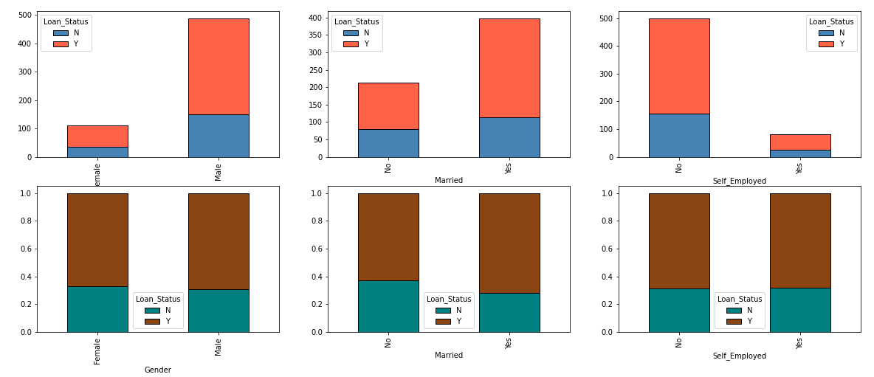
EDA
Univariate Analysis on Categorical Data
80% are Male Applicants, however both Male and Female have got equal proportion of Loan Approval
65% are Married and those who are Married have more chances to get Loan Approved
85% are Self_Employed, however equal proportion of Loan Approval

Slide 10
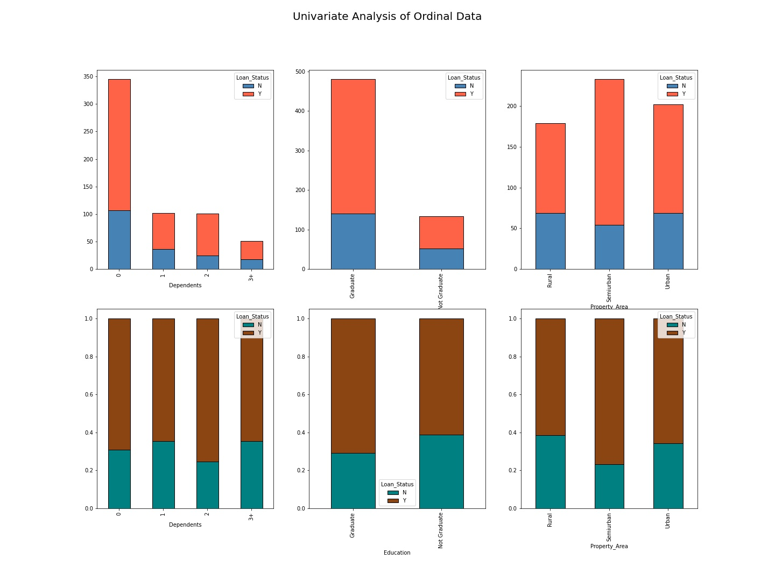
Univariate Analysis on Ordinal Data
57% are Parents have no Dependents (Newly Married or No Child).
However Bank has preferred to give Loan to Couple having 2 Dependents
78% are Graduate.
Those who are Graduate have greater chances of Loan Approval
37% are having Property in Semi-Urban area.
Those having property in Semi-Urban area have greater chances of Loan Approval

Slide 11
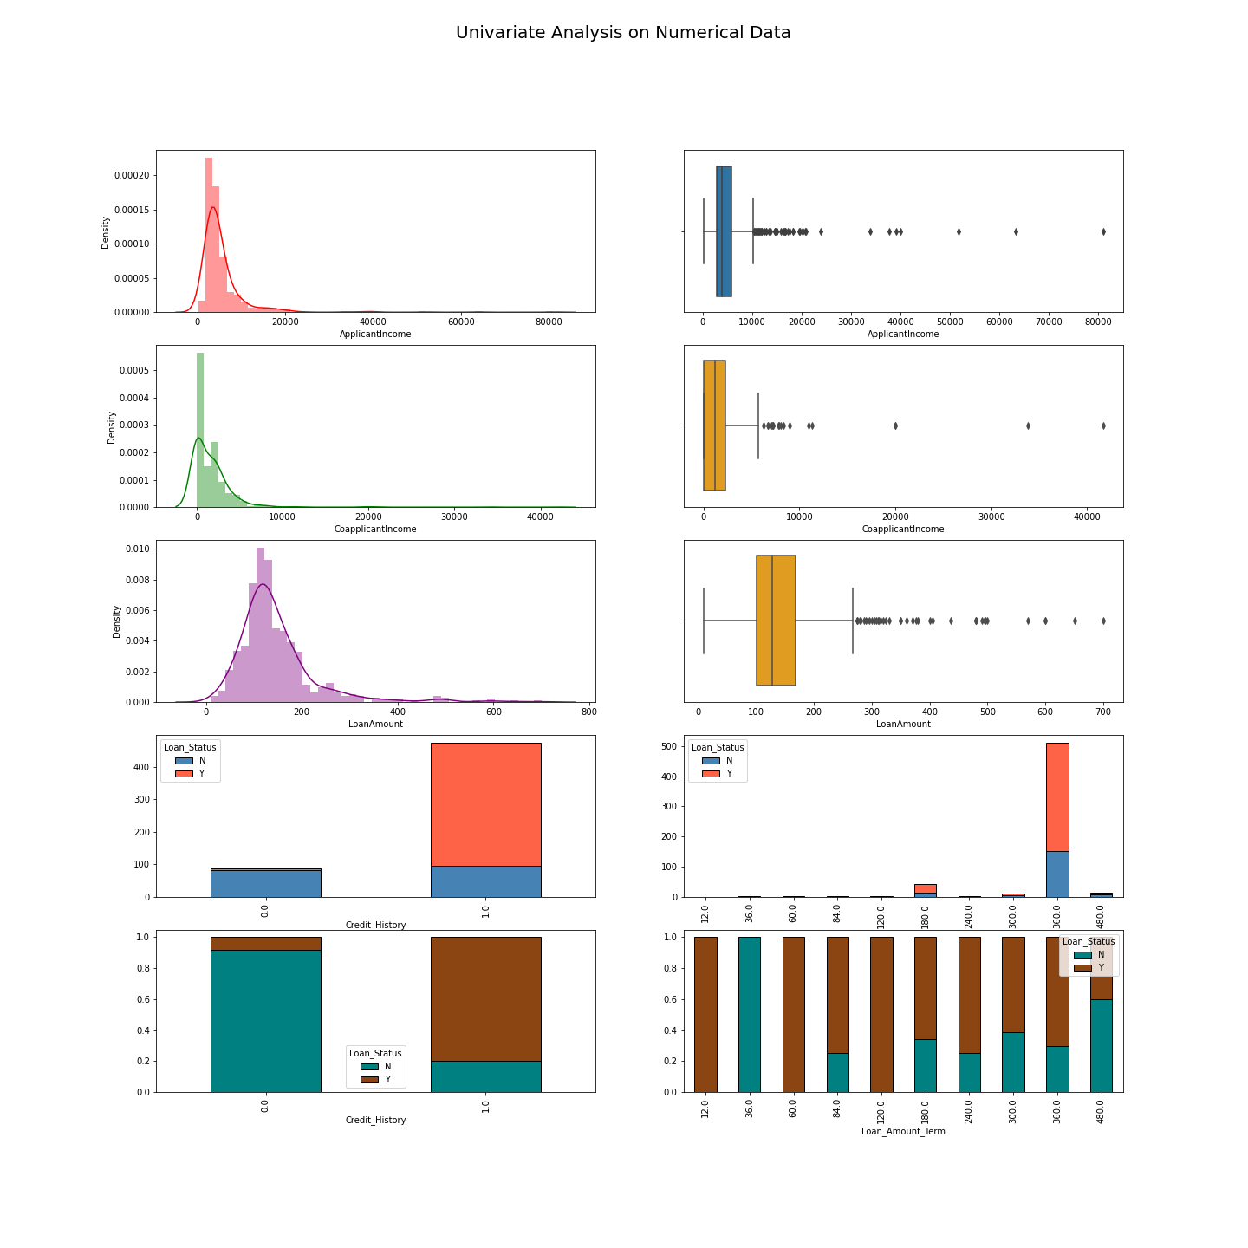
Univariate Analysis on Numerical Data
Most of the data seems to be right skewed as data congestion towards left side.
Also from the data we can conclude that if mean>median (Right Skew) else vice versa.

Slide 12
Univariate Analysis on Numerical Data
84% have Credit History as per guidelines, and mostly those whose Credit History meets guidelines have got Loan Approval
85% have 360 Months (30 Years) of Loan_Amount_Term, however people having Loan_Amount_Term of 1,5, & 10 Year have maximum chances of Loan Approval

Slide 13
Inferences from Data Visualization
1.1 Independent Variable [Categorical Type] :
Gender & Self_Employed Status doesn't make significant difference in getting Loan.
If you are Married then more chances of getting Loan.
1.2 Indpendent Variable [Ordinal Type] :
Parents with 2 Dependents have more chances of approval.
If you are graduated than more chances of Loan approval.
People owning property in Semi-Urban area have greater chances of Loan Approval
1.3 Indpendent Variable [Numerical Type] :
Most of data is Right Skewed except Loan_Amount_Term
Data also has some outliers present, thereby needs Data Transformation
People having Credit History as per guidelines and Loan_Amount_Term of 1,5, & 10 Years have got Loan approval
1.4 Dependent Variable [Target]
Almost 70% have Loan Approved

Slide 14
Hypothesis Post Data Analysis
Gender and Self_Employed have no significant effect on Loan_Status
If an applicant is Graduated having property in Semi-Urban area and is Married with 2 Dependents and Credit History as per Guidelines with Loan_Amount_Term of 1,5,10 Year then Loan is Approved
It is not necessary that higher income means higher loan amount for both Applicant Income and Coapplicant Income
Gender & Self_Employed is not a criteria for considering Loan Approval
Higher Loan Amount Lesser the chance of getting Loan Approved
Observations
Hypothesis

Slide 15
Data Processing

Slide 16
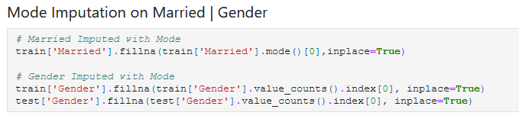

Treating Null Values
Mode Imputation on Gender and Married Column
Conditional Imputation on Dependents | Credit History | Self Employed | Loan Amount Term | Loan Amount
Mapping Property Area

Slide 17
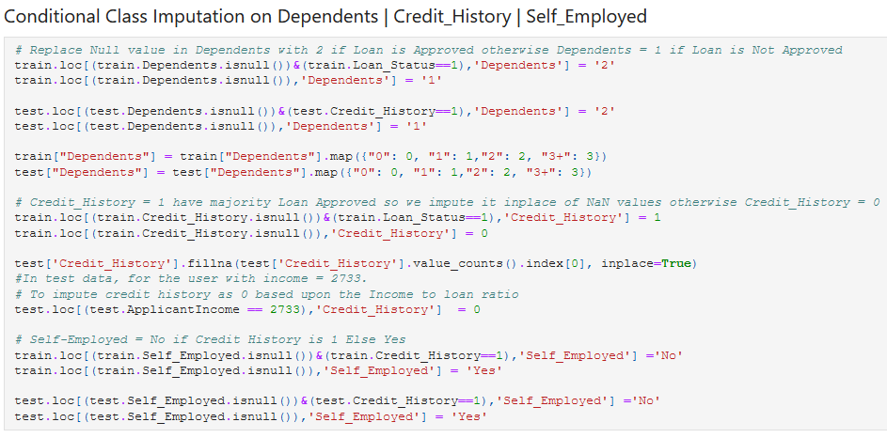
Treating Null Values
Conditional Imputation on Dependents | Credit History | Self Employed

Slide 18
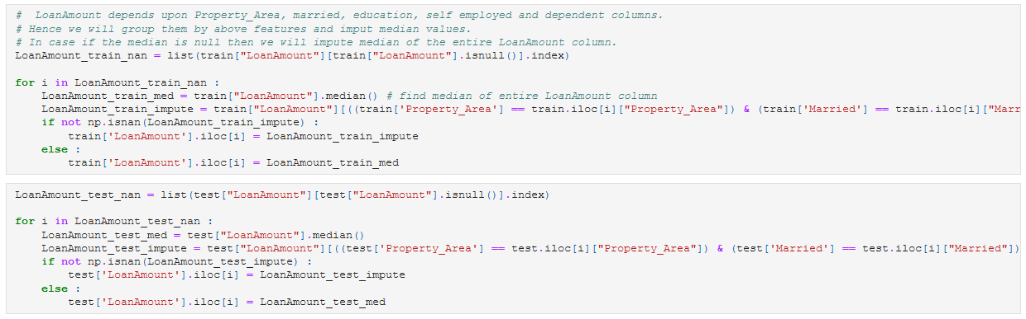
Treating Null Values
Conditional Imputation on Loan Amount

Slide 19
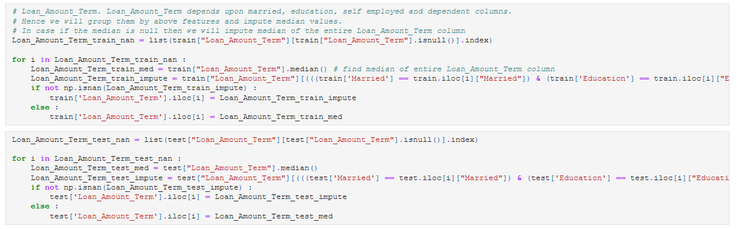
Treating Null Values
Conditional Imputation on Loan Amount Term

Slide 20
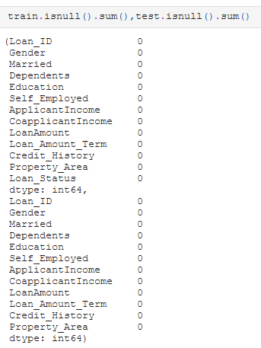
Treating Null Values
Train
Test

Slide 21
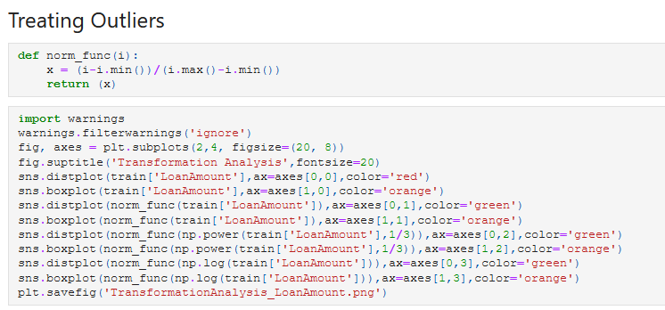
Treating Outliers

Slide 22
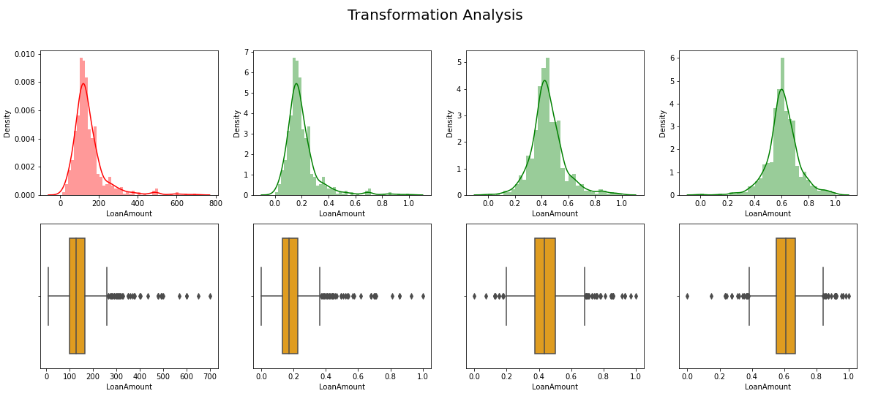
Treating Outliers

Slide 23
Feature Engineering

Slide 24
Total Income
But EMI also has interest rate and we consider 10% for monthly (10/100)/12 = 0.0083
EMI = $\frac{P×r×{\left(1+r\right)}^{n}}{{\left(1+r\right)}^{n−1}}$
EMI = (𝑃×𝑟×(1+𝑟)^𝑛)/(1+𝑟)^(𝑛−1)
r = Rate of Interest
n = Tenure of repayment or Loan_Amount_Term
Credit_History wise Total Income
Group Credit_History with sum of Total Income
Dependents wise LoanAmount
Group Dependents with sum of LoanAmount
Debt to Income Ratio
Ratio of LoanAmount to TotalIncome
EMI to Loan_Amount_Term
Ratio of EMI to Loan_Amount_Term
Property Grouping for Income Ratio
Group Property with Mean of Income Ratio
EMI = LoanAmount / Loan_Amount_Term
Applicant Income + Coapplicant Income
P = Principal Loan Amount
New Possible Features Generated
Source for Interest Rate : https://www.hdfc.com/housing-loans/home-loan-interest-rates Source for EMI Formula : https://www.bajajfinserv.in/home-loan-emi-calculator

Slide 25
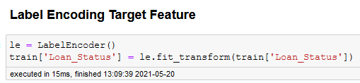
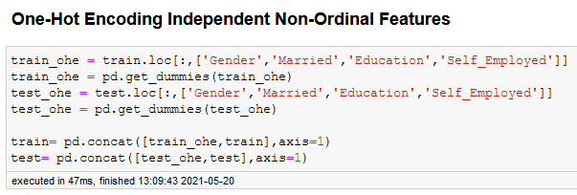
Category to Numerical Encoding
Label Encoding
Target Variable
One-Hot Encoding
Non-Ordinal and Independent Variables
Loan Status
Gender
Married
Education
Self-employed

Slide 26
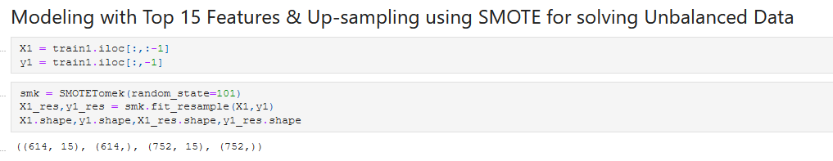
Feature Engineering
After Finding Features Train set has 25 Columns and Test has 24 respectively.
But After finding the ranks of Best Features we select Top 15 Features for building Classification Model.
Unbalanced Classes
We use SMOTE analysis and do Oversampling to give model equal chances to classify data.

Slide 27
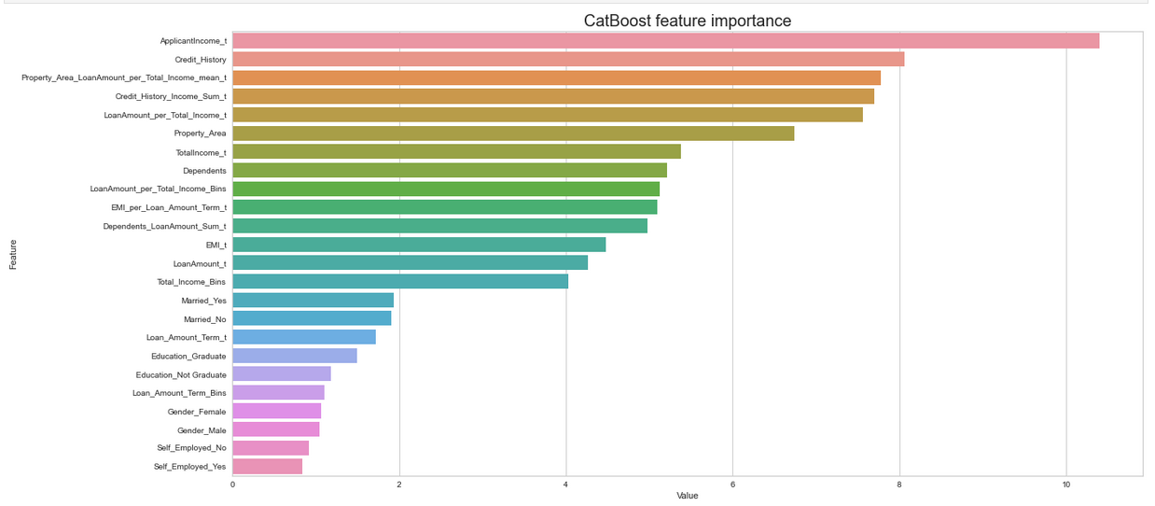
Selecting Top 15 Features

Slide 28
Model Summary

Slide 29
Sr. No. | Classification Models | Accuracy |  |  | ROC-AUC Score | Classification Report | Classification Report
 |  | Stratified K-Fold | Train | Validation |  | Accuracy | Precision |  | Recall |  | F-1 Score
 |  |  |  |  |  |  | N | Y | N | Y | N | Y
1 | Logistic Regression | 0.77 | 0.78 | 0.74 | 0.77 | 0.74 | 0.69 | 0.76 | 0.53 | 0.86 | 0.60 | 0.81
2 | Decision Tree | 0.78 | 0.79 | 0.76 | 0.72 | 0.76 | 0.70 | 0.78 | 0.58 | 0.86 | 0.63 | 0.82
3 | CatBoost Classifier | 0.76 | 0.99 | 1.00 | 1.00 | 1.00 | 1.00 | 1.00 | 1.00 | 1.00 | 1.00 | 1.00
Modeled with Top 15 Features (Feature Engineering)
4 | Logistic Regression | 0.73 | 0.73 | 0.78 | 0.85 | 0.77 | 0.80 | 0.76 | 0.69 | 0.85 | 0.74 | 0.80
5 | CatBoost Classifier | 0.85 | 1.00 | 0.84 | 0.93 | 0.84 | 0.77 | 0.93 | 0.93 | 0.77 | 0.84 | 0.84
6 | Decision Tree | 0.78 | 0.81 | 0.76 | 0.75 | 0.76 | 0.74 | 0.78 | 0.76 | 0.77 | 0.75 | 0.77
7 | Bagging Classifier | 0.79 | 0.84 | 0.80 | 0.85 | 0.80 | 0.79 | 0.81 | 0.79 | 0.81 | 0.79 | 0.81
8 | Random Forest Classifier | 0.79 | 0.84 | 0.80 | 0.87 | 0.80 | 0.82 | 0.79 | 0.73 | 0.86 | 0.77 | 0.82
9 | AdaBoost Classifier | 0.78 | 0.84 | 0.76 | 0.80 | 0.76 | 0.73 | 0.79 | 0.77 | 0.75 | 0.75 | 0.77
10 | SVM | 0.83 | 0.96 | 0.77 | 0.87 | 0.77 | 0.70 | 0.87 | 0.89 | 0.68 | 0.78 | 0.76
11 | Stacking | 0.82 | 0.85 | 0.78 |  | 0.78 | 0.76 | 0.80 | 0.77 | 0.79 | 0.77 | 0.80
12 | Extra Tree Classifier | 0.80 | 1.00 | 0.87 | 0.93 | 0.87 | 0.84 | 0.91 | 0.90 | 0.85 | 0.87 | 0.88
13 | Gradient Boost Classifier | 0.85 | 1.00 | 0.79 | 0.92 | 0.79 | 0.72 | 0.89 | 0.90 | 0.70 | 0.80 | 0.79
14 | Naive Bayes Classifier | 0.72 | 0.72 | 0.77 | 0.84 | 0.78 | 0.89 | 0.73 | 0.60 | 0.94 | 0.72 | 0.82
15 | KNN Classifier | 0.77 | 0.81 | 0.79 | 0.85 | 0.79 | 0.76 | 0.82 | 0.80 | 0.78 | 0.78 | 0.80
16 | XG Boost Classifier | 0.77 | 0.80 | 0.82 | 0.87 | 0.82 | 0.81 | 0.83 | 0.80 | 0.84 | 0.81 | 0.83
17 | Neural Network | - | 0.91 | 0.79 | - | - | - | - | - | - | - | -

Slide 30
Finding New Features
Data Processing
Deviation in Accuracy
Hardware Limitations
Challenges Faced

Slide 31
Bank Websites, Bank Employee
Studying Bank Terms
Hyperparameter Tuning
Checking Accuracy on Analytics Vidhya Portal
Overcoming Challenge

Slide 32
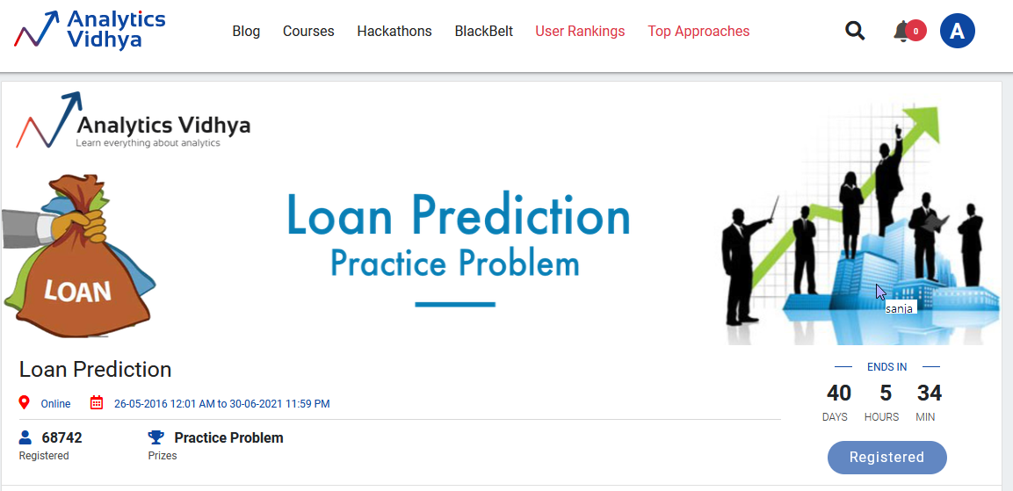
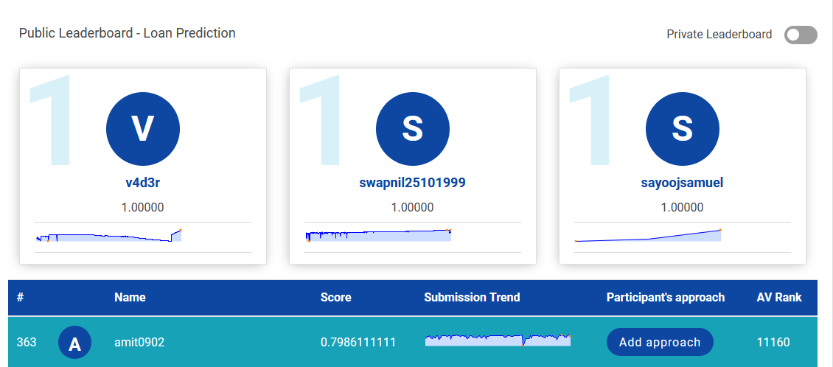

Slide 33
Next Phase
Try Improving Model Accuracy
Model Deployment
Work on Comments given by Mentor

Slide 34
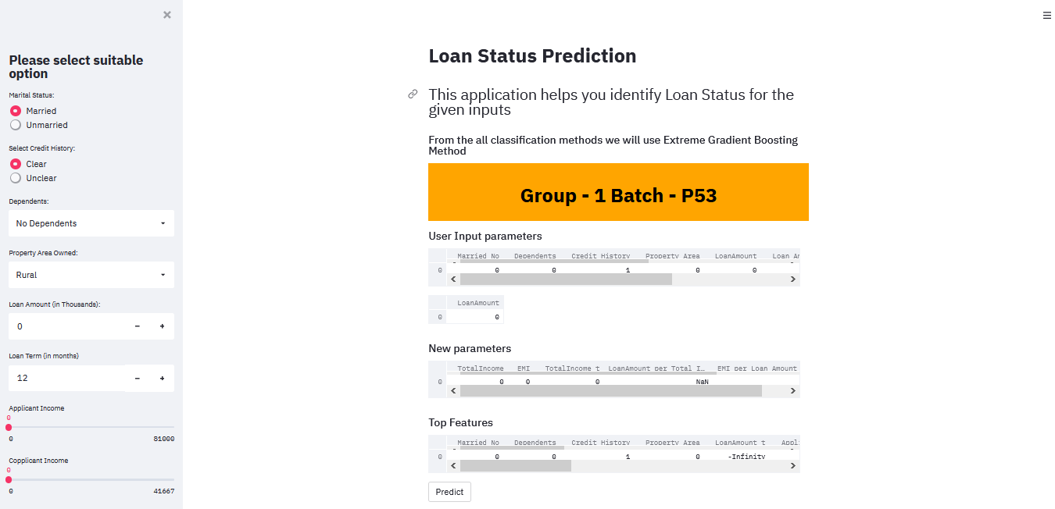
Model Deployment Screen

